Slide 1

PAN BARNET 2023
April 20th 2023
Face to face session – SLIDE DECK

Slide 2
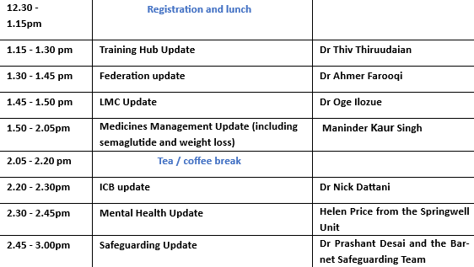

Slide 3


Barnet Training Hub update
Dr Thivyan Thiruudaian
April 2023

Slide 4


Workforce Supply
Workforce Development
Workforce Transformation

Slide 5

Workforce Supply* *Data collected over last 3 years
If you would like to participate in any of the above programmes, please contact Emily at barnet.cepnadmin@nhs.net
CLINICAL
55 GPs gained CCT
10 NQGPs SPIN/Fellows
47 GPs matched with mentors
13 GPNs trained
13 TNAs trained
NON-CLINICAL
71 prescribing clerks across 32 practices
32 GP Assistants across 17 practices
9 pre-registration pharmacy technicians across 8 practices

Slide 6
Workforce Development
Neighbourhood (Fuller Report)
Pan Barnet Events
Multiprofessional education events (e.g. burnout, green prescribing, asthma)
NCL Schwartz Round
Nurse education
Pharmacy education
PMLGs and coffee mornings
Care coordinator and social prescribing link workers sessions
If you would like to participate in any of the above programmes, please contact Emily at barnet.cepnadmin@nhs.net

Slide 7
Workforce Transformation
Support to implement the Long Term Conditions Locally Commissioned Service (BCF and LTC clinical leads)
Connect to local communities to create pipeline of health and care workers (PCAN)
Admiral Nurses supporting Carers for Dementia patients
Pan London GP Assistant bid
New Clinical Lead roles:
  Changes to access
  MDT working
  Multi-professional Education
  If you would like to participate in any of the above programmes, please contact Emily at barnet.cepnadmin@nhs.net

Slide 8
Federation Update
Thursday 20th April 2023
Dr Ahmer Farooqi

Slide 9
History
Why form a federation?
Increasing demand for access
Rising administrative and regulatory demands on practices
Workforce shortages – clinical and administrative
Reducing funding into general practices
To support collaborative working and develop resilience in general practice
Notes:
Primary care federations are key to supporting the health needs of local populations by acting as an extension of primary care and bringing together at scale and close to home health, social care and voluntary organisations.

Slide 10
History
Who are Barnet Federated GPs (BFG)?
Barnet Federated GPs CIC is a membership organisation
50 Barnet GP practices
Formed in November 2015 from practices in all 3 localities
Covering c.430,000 patients.
Board members were elected through their respective localities to represent the whole of borough
Notes:
Primary care federations are key to supporting the health needs of local populations by acting as an extension of primary care and bringing together at scale and close to home health, social care and voluntary organisations.

Slide 11
Services Delivered
Extended Access
In excess of 48,000 GP appointments per year across Barnet.
Community Anticoagulation Clinic
We provide safe and convenient primary care monitoring and management of anticoagulation therapy for patients.
Now part of the PCN Enhanced Access service complemented by the Bridging Service (111, Sunday, & Bank Holiday)
SMI Physical Health Checks
Supporting physical health checks for patients with Serious Mental Illness (SMI) through a ‘top-up offer’ to practices, with a central reporting function. Working in collaboration with voluntary sector organisations. In 2023-24 this will move towards a dedicated service team to support practices with this.
Smoking Cessation
Providing extended hours smoking cessation clinics, including a specialist pan-Barnet smoking in pregnancy service.

Slide 12
Voice for Primary Care & Supporting Practices
Supporting Practices & PCNs
HR & Finance: We have supported PCNs with recruitment and hosting of employment contracts, as well as finance and accounts.
At-scale purchasing: negotiating better deals and discounts on supplies and services for practices and PCNs. E.g. Practice Index, BlueStream, AccuRx & Ardens.
CQC Support: We helped practices prepare for and comply with the Care Quality Commission standards and inspections.
Voice for Primary Care
We represent and advocate for our practices and networks at borough level, working with the local ICB team, local authorities, voluntary sector, and other system partners.
Barnet Patient Participation Network (BPPN): We support and facilitate the engagement of patients and the public in the design and delivery of primary care services in Barnet.
Supporting GP Cabinet: We support the GP Cabinet, a representative body of Barnet GPs.
Voice for Barnet Primary Care: We act as a voice for Barnet primary care, raising awareness and promoting the achievements and challenges of our practices.

Slide 13
What we did during the Pandemic
COVID Face-To-Face Hubs
The Federation operated two covid face-to-face hubs at Finchley Memorial Hospital and Edgware Community Hospital, where we assessed and treated patients with suspected or confirmed covid-19 infection in a safe and separate environment.
Pulse Oximetry at Home
We supported patients and practices through the delivery of pulse oximeters, this supported the safe monitoring and treatment of patients with covid-19 symptoms at home.
RNOH Step-down ward
The Federation provided GP input to a step-down ward at the Royal National Orthopaedic Hospital, for patients who were recovering and needed further rehabilitation before returning home, freeing up beds during the second wave of the pandemic.
COVID vaccinations for patients with learning disabilities
We provided administrative support for covid-19 vaccinations for patients with learning disabilities, who were at higher risk of severe outcomes from the virus.
Rapid Response Team GP Input
We provided GP input to the Rapid Response Team, a multidisciplinary team that provided urgent care for patients who were at risk of hospital admission or deterioration.

Slide 14
You Said – We Did
Practice Support Team
The Federation’s practice support team provides a range of services and resources to assist practices in their daily operations and development.
Practice Managers IGPM Course
The Federation is pleased to announce that the first cohort of Practice Managers will shortly have completed the IGPM Accreditation.
Practice Managers Forum
The Federation facilitates a regular forum for practice managers to share best practices, network with peers, and access training and support.
Governance Support Offer to PCNs
The Federation offers governance support to PCNs to provide referral management, complaints and incidents processes, patient feedback, and clinical audit.
Practice Support Remote GP sessions
We support our member practices by providing additional GP sessions to cover staff shortages, ensuring continuity and quality of care for patients.

Slide 15
Evolving Role of the Federation
As PCNs continue to grow and mature, more clinical services are being delivered by PCNs or in partnership with PCNs eg. Enhanced Access.
The organisation will need to right-size and this will happen over the coming months
. The Federation will be looking to take strategic direction from the GP Cabinet.
With the incorporation of the Training Hub, we are involved in the wider workforce agenda

Slide 16
Thank you

Slide 17

Introduction to local medical committees and Londonwide LMCs
Dr Oge Ilozue
Barnet LMC Chair
Pan Barnet event 20th April 2023

Slide 18
Only LMCs represent GPs and practice staff across the whole profession.

Slide 19
Barnet LMC
Chair – Dr Oge Ilozue (PCN2)
Vice Chair – Dr Farzana Vanat (PCN6)
Committee Members
  Dr Claire Braham (OOH/locum)
  Dr Neel Clements (PCN 1W)
  Dr Hayley Dawson (PCN 1D)
  Dr Martin Harris (PCN6)
  Dr Jacqueline Santhouse (PCN1W)
Co-opted members – Dr Sinan Malley (VTS representative)
Observers
  Sandra Anderson (PCN manager observer – PCN3)
  Saira Khan (Practice nurse observer – PCN1D)
  Sanja Todorovic (Practice manager observer – PCN1W)

Slide 20
Current LMC activity
With strong support from the expert teams at Londonwide LMCs, your LMC is:
Involved in local leadership – Barnet GP Cabinet
Tracking contractual funding streams and challenging where they are not reaching practices.
Working on local enhanced service changes. Barnet currently has 14 LCS’ available to sign up for
Protecting and maintaining funding for IT such as Accurx.
Tackling the interface between general practice and hospital trusts.

Slide 21
Role of local medical committees
Democratically elected, representing all GPs at all levels.
Not trade union (this is the role of the BMA and other unions).
Recognised by commissioners since the 1911 National Health Insurance Act acknowledged independent contractor GPs.
Recognised by the newly created NHS in 1948 as the independent professional body representing GPs.
Open, transparent, fair and offering equal opportunities, accountable to only the GPs they represent. Free to speak up on behalf of GPs, practices, and patients when others cannot.

Slide 22
Role of local medical committees (cont.)
Consult with NHS bodies, integrated care systems (ICBs), local councils, police on issues that relate to general practice.
Work for and support individual GPs and practices and be the professional voice of general practice at a local level.
Support GPs via knowledge of contracts, systems, stakeholders at all levels, including borough, ICB, region and national.
Inform and engage with workforce development, planning, education and training for all roles within general practice.

Slide 23
Londonwide LMCs
Clinically-led independent voice of GPs in the Capital.
Formed in 2002 as a confederation of nearly all LMCs in London.
Supports and represents over 7,000 GPs and over 1,100 practices through our family of 27 locally elected committees representing GPs, practice teams and their networks delivering contracts in their patient communities
Staffed by a team of 50+ clinical and professional experts skilled in regulation, contract management and negotiation, HR, public affairs and stakeholder engagement, PR and marketing, media relations, education and training, data governance, professional development...
… all dedicated solely to supporting London practices.

Slide 24
Participating in your LMC
Spring and summer 2023 is the next election period.
Any NHS GP working in the area may stand for election.
Members are reimbursed for time spent on certain LMC activities.
Trainee GPs, nurses, practice managers and other roles play an active part in representing their peers, with observer posts filled once the election cycle has completed in the autumn.

Slide 25
Key election dates
Last week of April: nomination packs issued.
Wednesday 10 May, 1:00pm: first online networking event where GPs interested in standing can learn more about LMC membership.
Thursday 11 May, 1:00pm: second online networking event.
Friday 26 May, 5:00pm: nominations close.
Monday 26 June: voting papers go out in areas where there are more nominated candidates than LMC places.
Tuesday 25 July, 12:00pm: voting closes.
Monday 31 July: results published.

Slide 26
Get involved
Update your details
brt@lmc.org.uk
Elections page
lmc.org.uk/elections
General enquiries
info@lmc.org.uk
Twitter
twitter.com/LondonwideLMCs
LinkedIn
facebook.com/LondonwideLMCs
Facebook
facebook.com/LondonwideLMCs
Notes:
There are a number of ways you can get in touch with us.
If you have a general enquiry please contact our info account.
If you need FREE support or advice on work related issues such as contract terms, contact our GP Support team.
Visit our website for all the latest news, views, guidance and events.
We’re active on Twitter so follow us.
Our Facebook presence is worth looking at as well.

Slide 27
Pan Barnet Learning Event
20th April 2023
Medicines Management Update
Maninder Kaur Singh
Head Medicines Management
NCL ICB - Barnet Borough

Slide 28
Hot Topics
  Prescribing Quality Scheme (PQS) 22-23 & 23-24
  Continuous blood glucose monitoring
  NICE TA875 Semaglutide for managing overweight and obesity
  Tier 3 weight management
  NPR 2nd version on NCL GP website
  OVIVA/RAC project extension-prescribing oral nutrition supplements (ONS) in care homes 23/24

Slide 29
PQS Scheme 22-23
Target indicators-4th QTR 2022/23 ePACT data
Workbook indicators-submit by end of April 2023 via Citizen Space
PQS Scheme 23-24 out for consultation
Quality Audit (2) – Respiratory audit and second tbc(DES,LTC LCS)
Management of practice prescribing budget
Waste Review-reducing waste and oversupply in the repeat prescription prescribing process
Edoxaban in NVAF (rebate)
Cost effective switches
Ocular lubricants

Slide 30
Continuous glucose monitoring (CGM) access for patients living with type 2 diabetes- update
LPP and LDCN are currently developing an approach to guide implementation equitably across London of the NICE NG28 Guidelines
The implementation approach will proceed through governance at both London and ICS level, before being finalised and incorporated into local policy
Notes:
The NHS London Procurement Partnership (LPP) and the London Diabetes Clinical Network (LDCN)

Slide 31

NICE update
TA875 Semaglutide for managing overweight and obesity *NEW
  used for a maximum of 2 years, and within a specialist weight management service providing multidisciplinary management of overweight or obesity (including but not limited to tiers 3 and 4)
  Semaglutide (Wegovy®) is not yet commercially available in acute trusts or primary care
NCL JFC have reviewed- Semaglutide (Wegovy®) on the red list
Prescribing requests received from secondary care, community clinics or private providers should not be endorsed by primary care in NCL at this time.

Slide 32
Tier 3 Weight management service
NICE have recommended semaglutide in line with specific criteria, as an option for use in specialist weight management services (including Tier 3 and 4) which provide multidisciplinary management of obesity to support individuals to lose weight
Currently, there is no Tier 3 commissioned services in NCL however and an options paper for a NCL tier 3 weight management service is in progress
Tier 4 service- UCLH
Adult Weight Management & Dietetics - North Central London GP Website (icb.nhs.uk)
Notes:
Tier 1-Behavioural – Universal interventions (prevention and reinforcement of healthy eating and physical activity messages), which includes public health and national campaigns, providing brief advice.”
Tier 2- Lifestyle weight management services. Normally time limited
Tier 3- Clinician led multidisciplinary team (MDT) – A MDT clinically led team approach, potentially including physician (including consultant or GP with a specialist interest), specialist nurse, specialist dietitian, psychologist, psychiatrist, and physiotherapist.”
Tier 4 -Surgical and non-surgical – Bariatric Surgery, supported by MDT pre and post-op.”Performed in secondary care with pre-operative assessment and post-operative care and support. In practice these are the specialist weight management clinics that provide non-surgical intensive medical management with an MDT approach that consists of doctor with a special interest on obesity (physician or GP), specialist nurses, specialist dietitian, psychological support and specialist exercise therapists/physiotherapist.

Slide 33
NCL Prescribing Recommendations
Version 2 launched and available on GP Website
Changes include:
  Bempedoic acid and inclisiran added as per NCL lipid pathway
  Links to NCL gastroenterology pathways added
  Inhaler preferred choices aligned to NCL interim guidance
  Triptorelin added as preferred GnRH for prostate cancer in NCL
  All other changes have been emailed to practices
EMIS formulary has been updated and has been shared with all Practice Managers, Prescribing Leads and Pharmacists to import
https://gps.northcentrallondon.icb.nhs.uk/prescribing-guidelines/npr-ncl-prescribing-recommendations
Notes:
Formulary options will appear at the top of the picking list and will appear in black. Non preferred products will appear in grey, but it does not mean you cannot prescribe them. CDs all appear in red, whether formulary or non- formulary
Bempedoic acid – amber
and Inclisiran- amber
Triptorelin- amber – a NCL fact sheet on switching

Slide 34
OVIVA project-ONS review service care homes in Barnet
Commissioned service by NCL to reduce unnecessary expenditure on ONS
Implemented in 22-23, extended 23-24
Working with CLCH dietitians, to reduce time lag from referral to assessment
Use “Food first” tool and prescribe NCL recommended ONS if required
A virtual assessment and the referral pathway can be found on Bar Global
A sister service Rapid Assessment Clinic (RAC) launched 18/7/22 - to enable care home residents to be assessed virtually within 14 days
Notes:
RAC – started 18/7/22,anyone can refer ie GP, nurse, care home staff, pharmacist – a generic email for care home staff to send to OVIVA dietician
OVIVA- do less complex care home residents, if too complex OVIVA send to CLCH dietitians
Whittington-acute sector are referring care home residents to OVIVA
Virtual assessment done/need EMIS access- Oviva and RAC
CLCH dietician service as before

Slide 35
Thank you !
Any questions?
nclicb.mmtbarnet@nhs.net
nclicb.carehomepharmacistbarnet@nhs.net
Maninder.kaursingh1@nhs.net

Slide 36
NCL ICB – Barnet Directorate
Dr Nick Dattani
Clinical Director of Place
nclicb.barnetccgprimarycare@nhs.net
April 2023

Slide 37
NCL ICB Organisational Structure
Chief Executive Officer: Frances O’Callaghan
Chief Medical Officer: Dr Jo Sauvage
Chief Nursing Officer: Chris Caldwell
Chief Finance Officer: Phill Wells
Chief People Officer: Sarah Morgan
Chief Development and Population Health Officer: Sarah Mansuralli
Executive Director of Places: Sarah McDonnell-Davies
Executive Director of Corporate Affairs: Ian Porter
Executive Director of Performance and Transformation: Richard Dale
Deputy Medical Officer: Dr Sonali Kinra
Deputy Clinical Officer: Michelle Johnson

Slide 38
Place Directorate (Barnet)
Non-Clinical
Director of Integration: Colette Wood
Deputy Director Primary Care: Carol Kumar & Kelly Poole (job share)
Deputy Director of Transformation and Children: Daniel Morgan
Director of Integrated Commissioning: Jess Baines-Holmes
Head of Borough Integrated Borough Partnership: Tara Mooney
Head of Medicines Management: Maninder Kaur Singh
Clinical
Clinical Director of Place: Dr Nick Dattani
Clinical Lead: new clinical leads to be introduced in next slides

Slide 39
Barnet Borough Partnership (BBP)
Health Inequalities
  The health Inequalities workstream has focused initially on three core projects:
  cardiovascular disease prevention with emphasis on underserved groups
  inequalities in childhood immunisations
  oral health in pre-school children
  The objectives are:
  Deliver Healthy Heart Peer Support project to raise awareness of hypertension/ CVD prevention in Black African, Caribbean and South Asian communities
  Reduce inequalities in the uptake of childhood immunisations starting with MMR
  Barnet Young Brushers (BYB) Deliver supervised toothbrushing

Slide 40
Barnet Borough Partnership (BBP)
Children & Young People
  The following areas of focus have been identified as priorities for a Barnet CYP Integrated Care Strategy:
  CYP MH and Wellbeing
  Autism / Child Development Centre
  Asthma
  Family hubs / early help hubs
  Integrated child health programme / integrated paediatric system

Slide 41
Barnet Borough Partnership (BBP)
Mental Health & Dementia
  The following areas of focus have been identified as priorities:
  Implementing the new community model for MH by utilising system-level investment to support early intervention and prevention, enabling people to manage their mental health needs better in the community and reducing barriers to specialist care where needed
  Improving crisis support –investing in the development of local services that can support people in times of crisis and reduce escalation to specialist services
  Addressing MH inequalities –identifying and tacking areas of inequality in access, experience and outcomes
  Improving holistic care for adults with dementia and their carers –ensuring the local health and care offer is robust and able to meet a full range of needs

Slide 42
Barnet Borough Partnership (BBP)
Frailty
  The Community Frailty MDT is based on a successful pilot in PCN2 and engagement with partners on scale up and additions to the model.
  The plan is to roll out the frailty MDT model across Barnet establishing North and South frailty MDT for the borough is now in place and has started.
  The Pan Barnet MDT will provide anticipatory care for frail 65yrs+ living in the Borough of Barnet. Core MDT Membership includes a Geriatrician and Old Age Psychiatrist, Frailty nurse, OT, Physiotherapist, Dementia Nurse, Admiral Nurses and an Age UK MDT coordinator.
  The frailty service will provide personalised care plans for at risk patients, facilitating coordinated care closer to home, reducing risk of falls, improving patients’ quality of life by providing proactive support to families and carers in the community and minimising avoidable hospitals attendances and admissions.

Slide 43
Barnet Borough Partnership (BBP)
Neighbourhoods
  The neighbourhoods model aims to bring about a shift in the culture of how people approach health and care, making it more person-centred and allowing residents to build more personal resilience, increased confidence in self-management as well as addressing their health and social needs.
  The Neighbourhood model will adopt a strength and asset-based approach across all our teams within Neighbourhoods so that we start recognising the things that people and places have and gain an understanding of what a good life means for them.
  A dedicated neighbourhoods programme group and governance structure will lead the programme of work, support providers as they plan and implement changes and ensure consistent quality across the various projects being undertaken

Slide 44
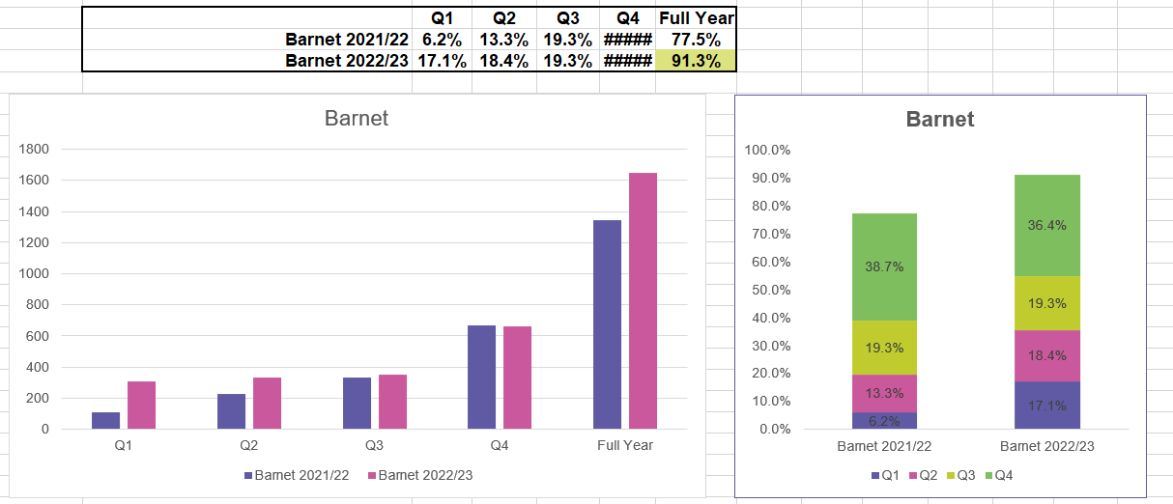
Annual Health Checks in Learning Disability Patents

Slide 45
Other General Updates
Phlebotomy
  The contract has been extended for a further 12 months (or until funding has been used)
LTC LCS
  Readiness period has started
  The LCS starts 1st October
  Communications have been sent and practices have returned their signed LCS contract
PCN DES/contract changes
Winter pressures funding
  Submissions from practices/PCNs to NCL for onward share with NHSE. Submissions demonstrated impact of funding and utilisation. Great work to everyone.

Slide 46
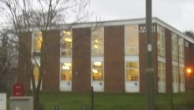
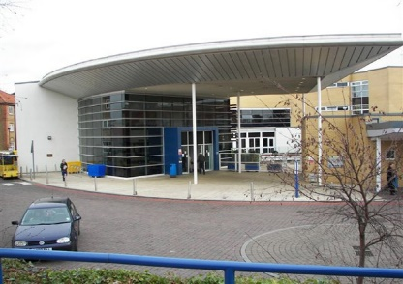
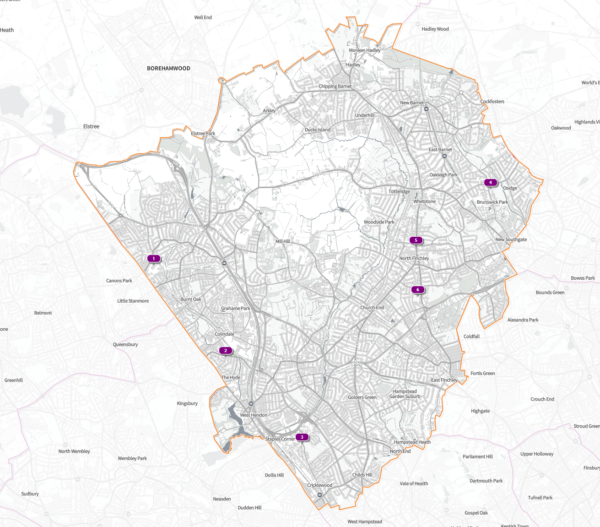
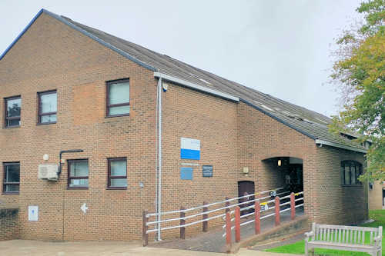
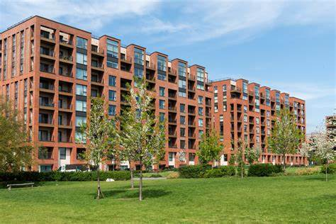
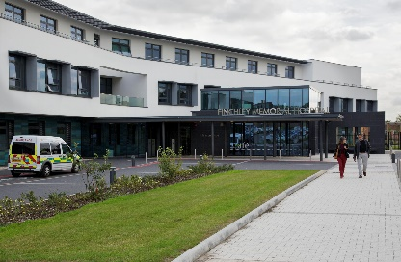
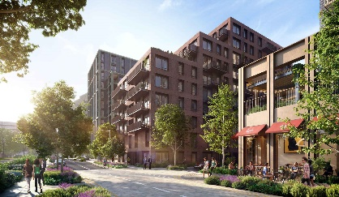
Barnet Estates Update
NHS NCL ICB (Barnet) has made significant progress on its estates and infrastructure agenda and there is a deep commitment to improving population health, along with the continued emphasis on quality and efficiency. The graphic below summarises some of the 23/24 Barnet priority Primary Care schemes. The schemes will algin with neighbourhood model and build on principles the Fuller Stocktake report and working group.
4) Osidge Library (OPE Scheme)
1) Edgeware Community Hospital (Optimisation)
5) Torrington Park Health Centre (Refurbishment)
2) Colindale Integrated Hub (New build)
3) Brent Cross Regeneration (New build)
6) The Finchley Memorial Hospital (CDC Programmer)
Notes:
https://app.shapeatlas.net/place/E54000028#13/51.6103/-0.2105/b-E09000003/sc-pc,sc-tmp,s-tmp/o-n,a/m-LA,ml-LA,mb-h,mb-hr/rh-0,rdr-t/e-LOC_50737,e-LOC_50738,e-LOC_50739,e-LOC_50740,e-LOC_50741,e-LOC_50742

Slide 47
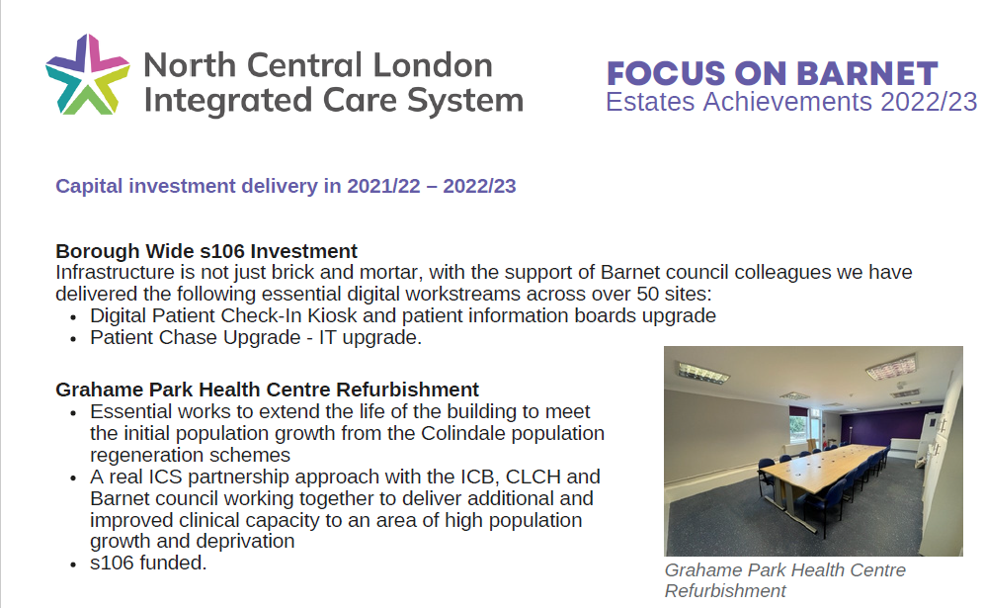

Slide 48
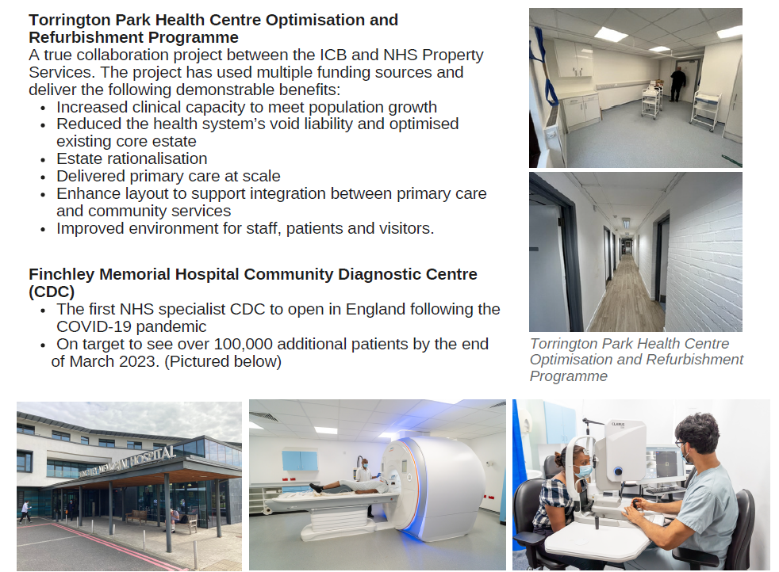

Slide 49
Clinical Leadership – Update
Start Well
Dr Jo Yong – Children & Young People & Maternity (if any project work required)
Living Well (1)
Dr Louise Miller – Mental Health, Diabetes & Weight Management (if any project work required)
Living Well (2)
Dr Afsana Bhuiya – Neighbourhoods & Inequalities (to include Fuller)
Living Well (3)
Dr Niro Kuganenderan – CVD/Stroke Prevention (if any project work required), Learning Disabilities and supporting with Neighbourhoods & Inequalities (where needed)
Ageing Well
Ms Michelle Humphrey – Long Term Conditions LCS, Frailty LCS, Respiratory network (if any project work required)

Slide 50
Questions?

Slide 51
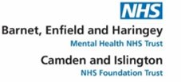
Barnet Community Mental Health Transformation Programme update
April 2023
Helen Price- Head of Community Operations
Angela Sobers- Community Service Lead

Slide 52
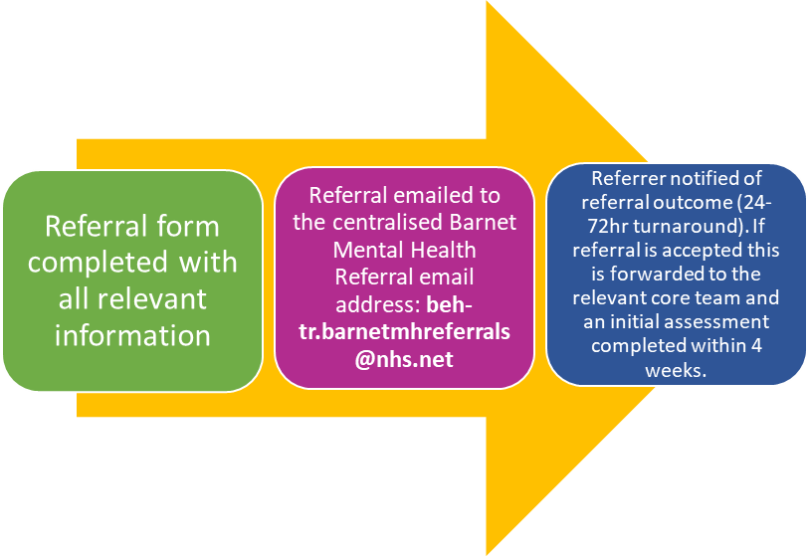
Non-urgent Mental Health Support:
There are two pathways that can be accessed for people to have Mental health intervention and support:
PCN’s who have Mental Health Practitioners/ Advanced Clinical Practitioners based in GP surgeries, can advise patients how to access this Specialist intervention, quickly and directly- without a referral through mental health services. The MHP/ACP will then support an intervention plan, utilising community offers (social Prescribing, IAPT or other VCSA offers) or a direct referral into the relevant Community team- if required.
Alternatively, a new Non urgent referral route has been designed- as below:

Slide 53
New non-urgent referral pathway:
The former Primary Care Link Working Team: Our Primary Care Link working team have now merged into our Core Community Mental Health teams, with the health care professionals becoming Wellbeing Practitioners.
MDT Discussion: Patients accepted to the core community teams following MDT discussion will be sent an initial appointment letter (within 4 weeks of referral date), which will detail the opt out process alongside a DIALOG + questionnaire which is to be completed prior to the appointment.
The new Barnet Triage Team: All non urgent referrals are received by the Barnet Triage Team. The Barnet Triage Team will screen the referral and if sufficient information has been received and referral is deemed suitable for the Barnet Community Mental Health services then the referral is passed to the relevant core community team for MDT discussion.

Slide 54

Mental Health Services- Referral Criteria
Our intention is to support people to access the best intervention as quickly possible. However, this does not always mean a mental health referral. Before making the referral to MH services please consider the following:
What action has already been taken, both medically and psychologically- social constraints impact on wellbeing however, this does not mean a psychiatric mental health intervention is required.
Before a referral is accepted, there will be a need to confirm that all other avenues and support has been utilised first- including MHPs/ACP’s in GP surgeries.
There must be a clear rational for referral and to aid our decision making referrals must include:
Consent
Referrer details
Personal demographic details
What support the person is currently receiving and from who? What has been tried
Reason for referral – what are you expecting from the Mental Health Services.
Current/historical risk
Physical health details
Current medications/treatment
Please note- If there is no evidence of the above, or that other support has been attempted, a referral will be returned with the advice for community resources that could be accessed. However, all referrals will be responded to within 5 days and if accepted, an initial appointment will be offered within 4 weeks.

Slide 55

Mental Health Services- Referral Criteria
Patients must be resident in the London Borough of Barnet and registered with a Barnet/ NCL/ NEL/NWL-GP
Patients who are 18 -65 years old experiencing significant mental distress or ill health which impacts upon their wellbeing and ability to manage daily life (with the ongoing work to support younger people 17+ to make transitions)
Patients requiring shorter term evidenced based psycho-social wellbeing support and education (with the support of the Well-Being practitioners within the core teams) where all efforts to support the person within a primary care setting (with the use of MHP’s/ ACP’s, social prescribers, IAPT etc) have been exhausted and there is a clear need for further intervention.
Service users requiring an assessment initiation of treatment for mental ill health in collaboration with a Consultant Psychiatrist and GP where efforts to treat within primary care guidelines have been exhausted.
All referrals assessed as “Urgent” should be referred to the Crisis Resolution and Home Treatment Team.

Slide 56
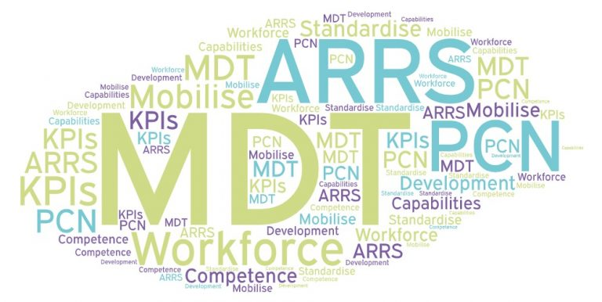
Advanced Clinical Practitioners and Mental Health practitioners- The Impact of the ‘ARRs roles’:
Working closely with clinical colleagues in Primary Care Networks to assess, diagnose and treat clients with significant mental illness or distress.
Ensuring there are no ‘cliff edges’ or ‘gaps in services’ in provision of mental health care- treatment and intervention.
Providing high quality and thorough mental health assessments including risk.
Providing short term evidence-based therapeutic interventions for clients presenting with a wide range of mental health needs.
Designing individual programmes of care collaboratively with patients to maximise self-management and social inclusion, while working with all community organisations to triage where required.
Refer directly into the Core Community offers for further assessment and treatment.

Slide 57
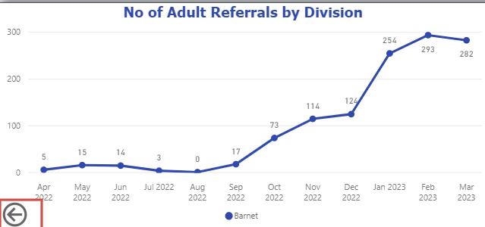
Impact of the ARRs roles- What's going well?
"Today's session was really helpful. It gave me another perspective on life so thank you"
I am so grateful for the support I received, and I do not know what I would have done without it"
Service users have Access to appointments direct via GP.
Collaborative working with a wide range of colleagues in GP practices, interfacing with all community resources to coproduce the best treatment plan using a biopsychosocial model and trauma informed care framework.
Provision of brief psychological intervention & support.
Facilitation of access to psychiatrist for advice, advise on and prescribe (once qualified) medication, or order tests and organise treatment.
Demand and capacity increasing since launch, mild to moderate presentations expected, however currently supporting people with mild to severe mental health difficulties with some requiring crisis intervention
" You do not how much it helps me to get on with my life, these sessions are therapy for me”

Slide 58

Updated: April 2023
WORKING AGE ADULT GP ADVICE - MEDICATION & GENERAL ADVICE FOR MENTAL HEALTH
BARNET
CrisisLine: 0800 151 0023 24/7
Complete and send Crisis Team Referral BEH v1 form (email to beh-tr.behcrisis.telephonehub@nhs.net)
Call Crisis Telephone Service to discuss:
0208 702 3620
NON-URGENT ADVICE
GENERAL ADVICE & MEDICATION ADVICE
via
BEH Crisis Telephone Service - GP Advice –
via Crisis Telephone Service (CTS)
Monday to Friday 9am -5pm.
0208 702 4382
NON-URGENT ADVICE
Barnet Triage Team
beh-tr.barnetmhreferralsadmin@nhs.net
support for GPs and other primary care staff for clients aged 18-64,
Monday to Friday 9-5pm

Slide 59

Clinical Approach- Trauma Informed Care:
NHS Long Term Plan; to move to a service model on which patients get more options, better support and properly joint up care at the right time in the optimal care setting
To this end Trauma Informed Care invites us to ask “what has happened to you”? rather than “What is wrong with you”?
Having this kind of conversation can help people to understand their distress and can offer hope for positive change.
The development of safe therapeutic relationships become the catalyst for this change
Recognising the expertise in lived experience and co-producing meaningful support plans and safety plans; recognising the strengths and expertise of all involved.
No decision about me, without me. To be mindful of not echoing or replicating previous trauma and making sure that power and control remains with the person.
To embed Trauma informed principles with our patients but additionally within our working relationships both individually and within teams.

Slide 60
DIALOG +
Key aspects of DIALOG+
Rating scale – outcomes, either positive or negative, are self-evident
Reviewing –the scores of the domain after summiting their answer. Great for reflecting.
Agenda-setting – by enabling the person to choose which areas they need help
Strength based approach – enabling the person to recognise strengths they have
Solution Focused Therapy – future focused, goal directed, focused on solutions
Shared decision-making - What can the client do, the professional do, and others do.
Co-producing –DIALOG+ is between 2 parties, not a 1-way street.
What is DIALOG +?
DIALOG is a scale of 11 questions. Service users will rate their satisfaction with eight life domains and three treatment aspects on a 7-point scale. DIALOG provides a score for subjective quality of life and a score for treatment satisfaction. DIALOG+ is a full therapeutic intervention that supports care-planning.
Aim of the tool: To improve quality of care by embedding trauma informed care planning throughout the NHS. The tool is designed to facilitate meaningful conversations with a person about their life and to identify the areas where they would like change.

Slide 61
Community Transformation Pathway Framework
Non-urgent referrals

Slide 62

Thank you.
Any questions please?

Slide 63

Child L CSPR

Slide 64
Background
Barnet care leaver and her 3 year old son, Child L, both known to multi agency services within Barnet & Brent.
Father is also a care leaver and a perpetrator of domestic abuse upon mother whom at time of incident was not in a relationship with mother.
Child L subject to Supervision Order under management of Brent.
At time of incident mothers current partner, also a care leaver, and former known associate of Child L’s father but were on unamicable terms.
Presentation
Child L presented to A&E in April 2021 with 36 bruises.
The child protection medical concluded these were non-accidental injuries or neglectful
Child L is now in care of local authority

Slide 65
Findings:
Extensive multi-agency involvement with Child L and mother across boroughs, health, early years, housing , social care and domestic violence
Police handover – Child L was in hospital under a police protection order, however police officers did not hand over fully between shifts and some police officers were not adequately briefed on their role.
Move to Northern Ireland – it would have been good practice for Brent to notify Northern Ireland authorities about Mother and L’s move particularly in light of father’s upcoming release
GP follow-up – when the GP sent L and mother to A&E for the bruises on face, the GP should have called ahead to the hospital and made arrangements for if they did not show up.
Understanding of the personal advisor role when heavily involved in complex child protection matter

Slide 66
Recommendations:
Seeking assurances that the role of the ‘Lead Professional’ and the skills and experience required for this role are clearly defined, understood and embedded within any Team Around the Family arrangements
Liaise with relevant London GP bodies to establish an agreed protocol on sharing information about children and families for child protection assessments and interventions to ensure that key information, decisions and actions are easily summarised, accessible and captured. It is recommended that a standard child protection data sharing form is sent to GPs for completion, and that this is a form based on the template developed by the National Named GP Group. (Prashant-Can you expand on this?)
Develop best multidisciplinary practice guidance where services to parents and children are provided across more than one local authority, such as joint supervision arrangements, transfer of key information, transition of new working relationships and timing to ensure that the needs of children and their parents who are care leavers are met.
Safeguarding Children Partnerships and their member agencies should review how frontline practitioners and managers are supported in their understanding and skills in supporting emotional attachment between carers and children.

Slide 67
Key lines of enquiry
Exploring ‘professional curiosity’ particularly as to whether mother was sufficiently challenged about her versions of events after Child L’s various injuries and whether appropriate safeguarding judgements were made.
Were the ‘second questions’ and appropriate challenge evident? Was the impact of domestic violence minimised? How mother was understood as a victim and suitable services provided?
Support for families after Supervision Orders end and value of SOs in protecting children.
Coordination between local authorities, where one is providing care leaver support to the parent and another is safeguarding the child.
What, if any, was the impact of the pandemic on service provision/safeguarding arrangements? Was there any paying attention to the cumulative impact of abuse/neglect on Child L?

Slide 68
Bruising protocols –Non-mobile and mobile children -Published Feb 2023
https://thebarnetscp.org.uk/bscp/news/bscp-publishes-its-reviewed-protocols-upon-bruising-in-mobile-and-non-mobile-ch
Multi agency audit on neglect
Focus on neglect as priority
DA/VAWG strategy
Link for Child L The Barnet Safeguarding Children Partnership - About the BSCP (thebarnetscp.org.uk)

Slide 70
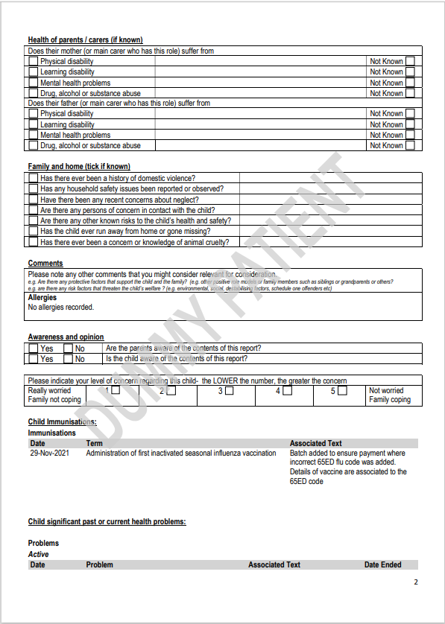

Slide 71
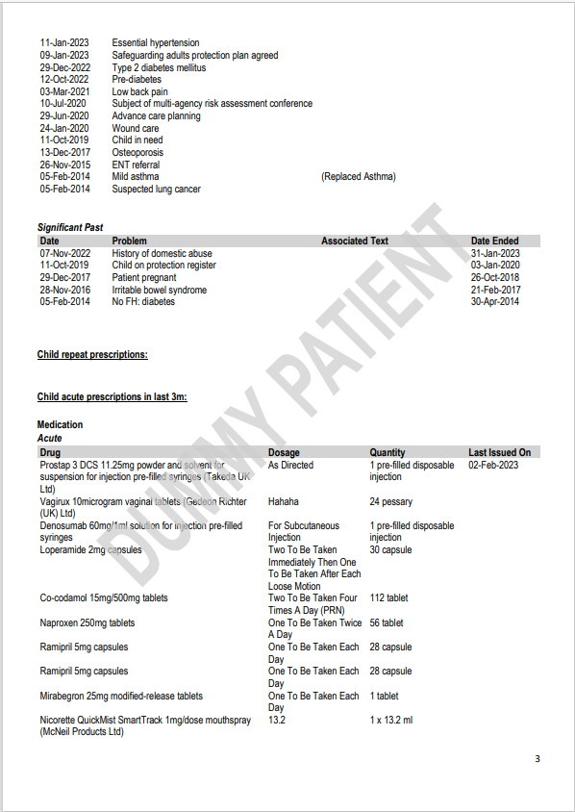

Slide 72
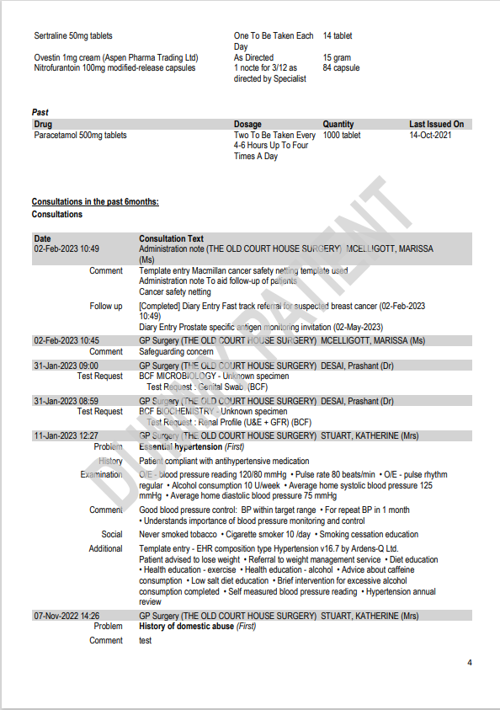

Slide 73
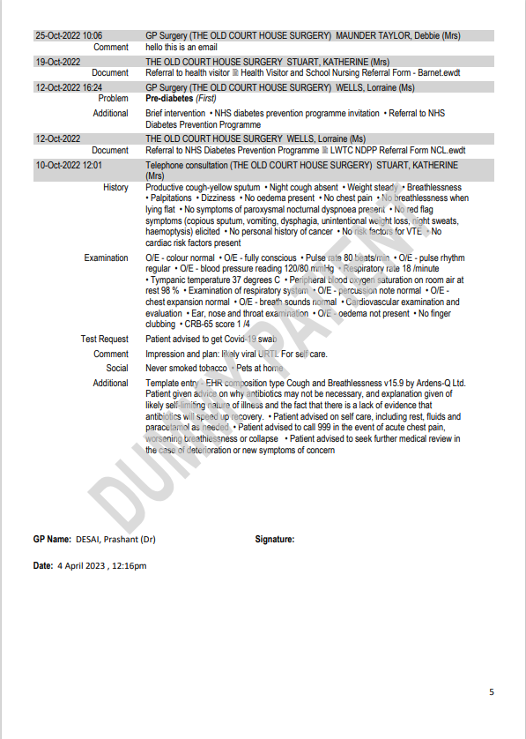

Slide 74
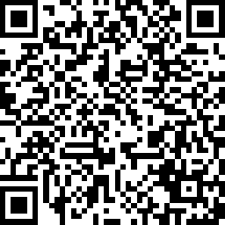
Thank you for coming
Please complete the feedback now or when you receive the slide deck
Safe journey home
https://www.surveymonkey.co.uk/r/CRV3QJD

